Slide 1


Slide 2
Gentle surprise
is the foundation
of delight.

Slide 3
Gentle surprise
is the foundation
of delight.
Without an element of surprise, there can be no delight.

Slide 4
“The important
thing in writing
is the capacity
to astonish.
Not shock
– shock is a worn-out word –
but astonish.”
– Terry Southern

Slide 5
What is Your
Origin Story?

Slide 6
I was a ten year-old boy holding a flashlight for my Dad while he worked on an air conditioner for a customer. His name was Duncan Goodrich. He didn't talk much. But there's a certain kind of magic that happens when a son holds a flashlight for his father. I held it steady and quiet and Dad talked to me while he worked. He said, "When a person needs help, you respond right away. Not when it's convenient for you." He said, "Always do the right thing. Always do what's right." And he said, "The Goettl Iron Horse is a magnificent machine. Nothing else even comes close." That was the first night I held a flashlight for my Dad but it wouldn't be the

Slide 7
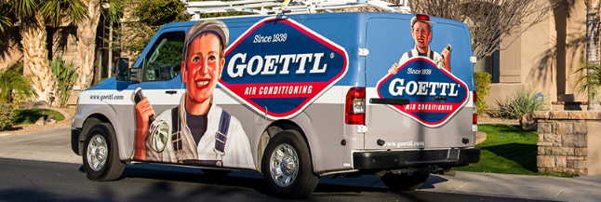
last. At Dad's funeral, I realized that every time he handed me that flashlight, he was passing the torch. And my Dad believed in Goettl air conditioners. So I bought the company. Goettl. Gee Oh Ee, T-T-L.
It'll keep you cool, but it's hard to spell. You can count on us to respond right away and do the right thing... Always. No one knows air conditioning like Goettl. G-Oh Ee, T-T-L.

Slide 8
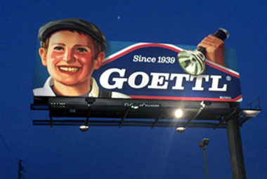

Slide 9

REMEMBER:
The goal of an
Origin Story
is to communicate
your motivations
and values.

Slide 10
REMEMBER:
The goal of an
Origin Story
is to communicate
your motivations
and values.
It is BONDING,
not advertising

Slide 12
RECRUITMENT AD

Slide 13
RECRUITMENT AD
Are you a gracious host and entertainer?
That may seem like a crazy question to ask when the job is basically lift-and-carry.
But if you’ll read a little further, you’ll understand why I need to ask it.
Are you a happy, upbeat person?
Do people like to be around you?
Do you have that cheerful,
get-it-done type of grit
and determination?

Slide 14
Would you like to work for a company that believes in you and has big plans for your future?
I dropped out of college when I discovered what I wanted to do. What I’m about to say may sound crazy, but I was waiting in the drive-thru line at McDonald’s when everything around me began to glow. It was that famous moment you always hear about. You know, when the angels start to sing and you suddenly know the answer to every question.

Slide 15
It began when I saw an old pickup truck with the words Junk Hauling and a telephone number spray-painted on the sides of the bed and I said, “I could do that.”
My life changed forever in that moment.
That’s the sort of moment I want you to have.
1-800-GOT JUNK? is the world’s largest full-service junk removal company. We’re in every important city and town in the US, Canada and Australia. Dozens of millionaires have made their fortunes in our company.

Slide 16
I want that to happen to you, too.
Don’t worry. I’m not trying to sell you anything. You don’t have to pay for any classes or buy any motivational tapes or anything goofy like that.
I just want to give you a job.
I just want to be part of your future.
You’re still reading? Excellent!
I’m feeling better and better about you.

Slide 17
A few months after my McDonald’s moment,
I had 5 trucks and 11 employees! We were making plenty of money but I wasn’t happy. Not even a little bit. The company I saw in my mind that day wasn’t the company I was running. Each morning I woke up a little more bummed out than I was the day before. Finally, I went all alone to a little cabin at the seashore to see if I could figure out what was wrong.

Slide 18
I experienced my second big moment in that cabin when I wrote down on a sheet of paper exactly what I had seen in my mind:
Clean, shiny trucks. Proud drivers with bright eyes wearing snappy uniforms, shirttails tucked in, super-professional. And when they knocked on people’s doors, they were smiling!
And the people who opened those doors were smiling, too!

Slide 19
After my seaside experience in the cabin, I went back to my business and fired all 11 of the people who worked for me. It was the hardest thing I’ve ever done because I really liked every one of them. But they weren’t the people I had seen in my mind. The people I saw in my mind were people like you.
Are you beginning to understand my opening question, “Are you a gracious host and entertainer?” A gracious host is a person who makes everyone feel comfortable.

Slide 20
An entertainer is someone who works hard to make sure everyone is having a good time. These are the people who make other people smile.
If you’re one of those people – and I think you are – here’s what you need to do next:
[PROVIDE CONTACT INSTRUCTIONS THAT WILL ALLOW APPLICANTS TO REACH US.]
I want everything around you to begin to glow.
I want you to hear angels sing.
Brian Scudamore,
CEO, 1-800-GOT-JUNK?
© 2017 Roy H. Williams Marketing

Slide 21


Slide 22
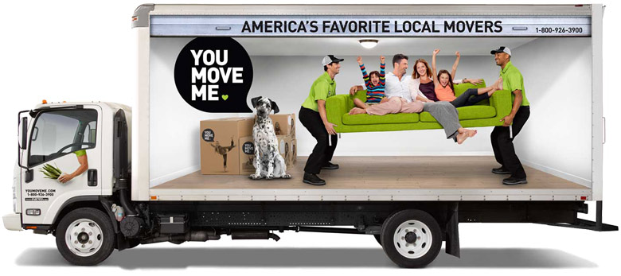

Slide 23
My wife and I were moving to a new house.
I had met a guy who owned a moving company, an old family business. He said, "Hey. If you're ever gonna move, here's my card. I'm your guy. I'll give you the VIP treatment.”
I kept the card and I called him.

Slide 24
My wife and I were moving to a new house.
I had met a guy who owned a moving company, an old family business. He said, "Hey. If you're ever gonna move, here's my card. I'm your guy. I'll give you the VIP treatment.”
I kept the card and I called him.
One of their branding messages is guaranteed on-time arrival.
They were 45 minutes late.

Slide 25
We had just installed brand new carpet in the basement, to which they added a dark brown stripe of muddy footprints.

Slide 26
We had just installed brand new carpet in the basement, to which they added a dark brown stripe of muddy footprints.
The movers were all wearing iPhone ear buds. They would shout, "Where does this box go?"
So I'd tell them and they'd shout,
"Where? What?"
I wanted to say, "If you took out your ear buds, you'd be able to hear me." But I just smiled and shouted a little louder.

Slide 27
I heard them upstairs saying,
"I think we have a problem."
So I went up there and I said,
"How can I help?"

Slide 28
I heard them upstairs saying,
"I think we have a problem."
So I went up there and I said,
"How can I help?"
After struggling to get our mattress up the narrow stairwell, they had unzipped the mattress cover and took our organic cotton mattress apart.
You know when you make a lasagna and you've got all those layers of noodles and it's a

Slide 29
bit of a mess? That was our mattress.
We had to get a new one.

Slide 30
bit of a mess? That was our mattress.
We had to get a new one.
Who unzips a mattress cover and takes the mattress apart?
I mean, it was just one thing after another.

Slide 31
bit of a mess? That was our mattress.
We had to get a new one.
Who unzips a mattress cover and takes the mattress apart?
I mean, it was just one thing after another.
You Move Me was born when they knocked the head off my wife's favorite plant and
killed it.
Lara really loved that plant.

Slide 32
I got together with 4 successful friends and we spent 2 days envisioning the perfect moving experience, and figuring out how to deliver it.
We launched that business in Chicago with 34 franchise partners and You Move Me has been gaining momentum ever since.

Slide 33

I got together with 4 successful friends and we spent 2 days envisioning the perfect moving experience, and figuring out how to deliver it.
We launched that business in Chicago with 34 franchise partners and You Move Me has been gaining momentum ever since.
Go to YouMoveMe.com
Your carpets, your mattresses
and your plants
will love you for it.

Slide 34


Slide 35
I needed to get my house painted so I reached out to a handful of friends on Facebook and said, "Hey, who should I look at for getting my house painted?"

Slide 36
I needed to get my house painted so I reached out to a handful of friends on Facebook and said, "Hey, who should I look at for getting my house painted?"
Two friends recommended companies I had heard of, so I called both companies and asked for an estimate.
A third friend, one of my favorite people, said, "There's a company called One Day Painting, you should talk to this guy Jim."

Slide 37
So the first two guys pulled up and they reeked of cigarette smoke the moment they walked in the door. They were late, they weren't organized, and they weren't in uniform. I didn't have a good feeling about them.

Slide 38
So the first two guys pulled up and they reeked of cigarette smoke the moment they walked in the door. They were late, they weren't organized, and they weren't in uniform. I didn't have a good feeling about them.
But then the third guy walks in, Jim Bodin. He's uniformed. His estimating system is on an iPad, and he's got a shiny van outside that says, "One Day Painting." I thought, "Okay, this is good."

Slide 39
Jim said, "My prices are going to be the same as everyone else's, and my quality is going to be excellent. The kicker is that when we agree on a painting day, I'll have your house done in a day."

Slide 40
Jim said, "My prices are going to be the same as everyone else's, and my quality is going to be excellent. The kicker is that when we agree on a painting day, I'll have your house done in a day."
I said to him, "Are you kidding me?"
He said, "Look at the van outside.
One Day Painting. It's what we do."

Slide 41
"I don't know how that's possible, but okay," and we shook hands. But I was thinking in my mind, "Even if it takes 2 days, it's a whole lot faster than 2 weeks."

Slide 42
"I don't know how that's possible, but okay," and we shook hands. But I was thinking in my mind, "Even if it takes 2 days, it's a whole lot faster than 2 weeks."
I booked the painting day and came home at 6:30 that evening. Floor to ceiling, the walls were perfect, as were all the moldings and trim. And the kitchen needed 3 coats because of the dark color that had previously been there. It, too, was immaculate. The job was perfect. I was blown away.

Slide 43
I called Jim, "Thank you! Unbelievable! Great service! Have you ever looked at franchising your business?"

Slide 44
I called Jim, "Thank you! Unbelievable! Great service! Have you ever looked at franchising your business?"
Shortly after that, I was in Florence, Italy, with my family. We were walking along when we saw this wonderful little gelato shop with 50 flavors. One of them had a smiley face on top made from half a lime and a couple of little pieces, so I said, "I want that flavor. It's smiling at me. It's talking to me."

Slide 45
I took a photo of that gelato and sent it to
our logo designer with a text message,
"Capture this magic for Wow 1-Day Painting.”

Slide 46

I took a photo of that gelato and sent it to
our logo designer with a text message,
"Capture this magic for Wow 1-Day Painting.”
You wake up and your house is one color,
you got to bed and it’s another.
WOW 1-Day Painting is happy magic.

Slide 47


Slide 48
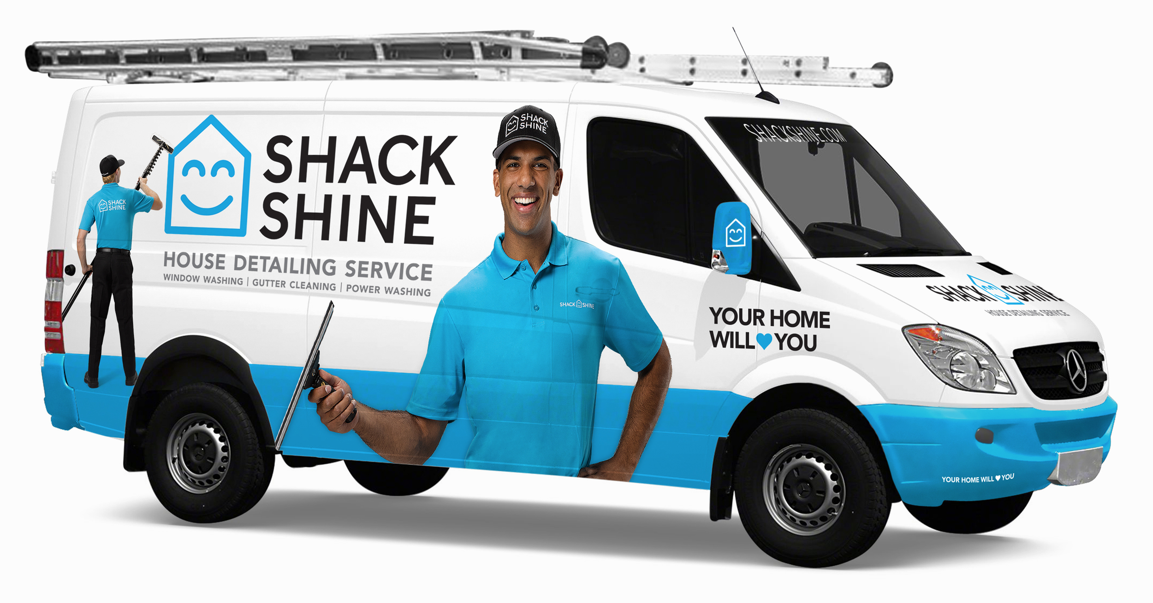

Slide 49
Rain was gushing down the side of the house so that every time you walked outside you got soaking wet. My wife, Lara, said, "You've got to get those gutters cleaned."

Slide 50
Rain was gushing down the side of the house so that every time you walked outside you got soaking wet. My wife, Lara, said, "You've got to get those gutters cleaned."
So I went online and began calling people who said they cleaned gutters, but they weren't returning my phone calls. I'm leaving messages. I'm sending emails. But not a single person got back to me. Zero. I literally got no response from any of the companies on Google or Craig's List.

Slide 51
I was telling my story to Lee Adler.
"I can't find anyone to clean my gutters.
It's driving me nuts."
Lee said, "Call Igor. He's working with a guy named Dave at a business called Shack Shine."

Slide 52
I was telling my story to Lee Adler.
"I can't find anyone to clean my gutters.
It's driving me nuts."
Lee said, "Call Igor. He's working with a guy named Dave at a business called Shack Shine."
Shack Shine cleaned my gutters and I was blown away by the service. It was thorough,
it was quick, it was great.
Dave sent me an email and asked,
"So, how was it?"

Slide 53
I replied, "Awesome. It was completely awesome."
He said, "I think Shack Shine should be
part of O2E Brands."

Slide 54

I replied, "Awesome. It was completely awesome."
He said, "I think Shack Shine should be
part of O2E Brands."
I said, “That’s funny, Dave, because
I was just thinking the same thing.”
Shack Shine delivers
the kind of magic
I believe in.

Slide 55
1. Tell your group
the story of
Why and How
you got into this
Business.

Slide 56
2. Write your origin story.
Make it short enough that it can be read out loud less than 90 seconds.

Slide 57
3. Stand and read
your origin story.

Slide 58

1.
What are the
defining
characteristics
that make this
character think,
speak, act and see
the world as they do?
4.
3.
2.

Slide 59
North
Star
Obvious
What are the
defining
characteristics
that make this
character think,
speak, act and see
the world as they do?

Slide 60
North
Star
Obvious
What are the
defining
characteristics
that make this
character think,
speak, act and see
the world as they do?
CounterStar
Surprise

Slide 61
North
Star
Obvious
What are the
defining
characteristics
that make this
character think,
speak, act and see
the world as they do?
Vulnerability
Weakness or Flaw
CounterStar
Surprise

Slide 62
North
Star
Obvious
What are the
defining
characteristics
that make this
character think,
speak, act and see
the world as they do?
Vulnerability
Weakness or Flaw
Core
Identity
CounterStar
Surprise

Slide 63
Magical
Happy, Likeable
Professional

Slide 64
Magical
Happy, Likeable
The
vertical axis
is public,
outward-facing.
Professional

Slide 65


Slide 66


Rat
Gourmet
Chef
Remy from Ratatouille

Slide 67
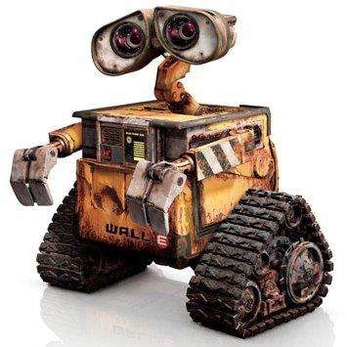
Machine
Romantic,
Sentimental
WALL·E

Slide 68
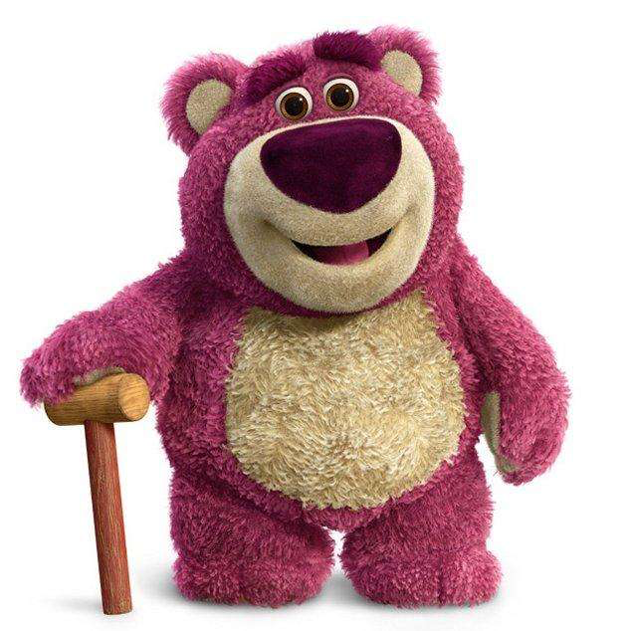
Teddy
Bear
Sinister,
Evil
Lots-o'-Huggin' Bear

Slide 69
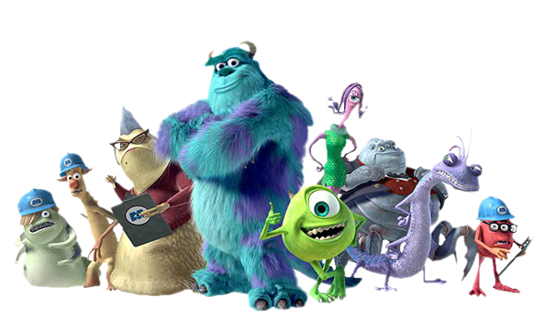
Monsters
Terrified of
Humans
Monsters Inc.

Slide 70
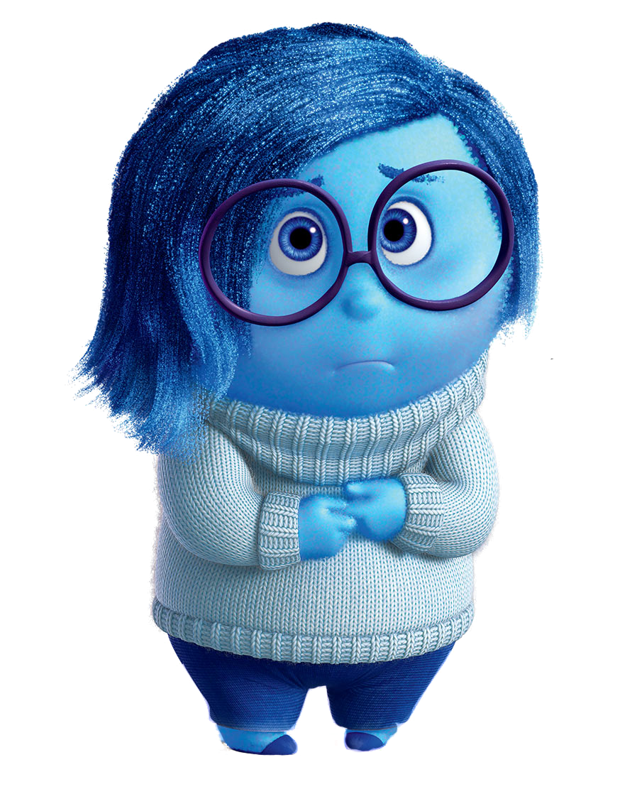
Sadness
The Key to Feeling
Better
Sadness

Slide 71
All 4 brands developed
by Brian Scudamore
are built on the
same character
diamond.
North
Star
Obvious
Vulnerability
Weakness or Flaw
Core
Identity
CounterStar
Surprise

Slide 72
Magical
Happy, Likeable
Vulnerability
Weakness or Flaw
Core
Identity
CounterStar
Surprise

Slide 73
Magical
Happy, Likeable
Vulnerability
Weakness or Flaw
Core
Identity
Professional
Uniformed
and Crisp

Slide 74
Magical
Happy, Likeable
Expensive,
Costly
Core
Identity
Professional
Uniformed
and Crisp

Slide 75
Magical
Happy, Likeable
Expensive,
Costly
Honest
Professional
Uniformed
and Crisp

Slide 76
Expensive,
Costly
Honest
The
horizontal axis
is foundational,
inward-facing.

Slide 77
Magical
Happy, Likeable
The
vertical axis
is public,
outward-facing.
Professional
Uniformed
and Crisp

Slide 78
1. Create the character diamond for your brand

Slide 79
2. Write 16 True Statements about your company that will convince us to
choose you.

Slide 80
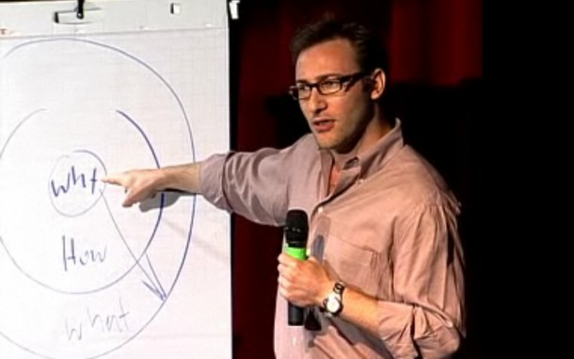
Simon Sinek, TED-X Puget Sound

Slide 81
“People don’t buy what you do, they buy why you do it. And what you do simply proves what you believe.
In fact, people will do things that they believe.”

Slide 82
“People don't buy what you do; they buy why you do it. The goal is not to do business with everybody who needs what you have. The goal is to do business with people who believe what you believe.”
5:30

Slide 83
“The goal is not just to sell to people who need what you have; the goal is to sell to people who believe what you believe. The goal is not just to hire people who need a job; it's to hire people who believe what you believe. I always say

Slide 84
that, you know, if you hire people just because they can do a job, they'll work for your money, but if they believe what you believe, they'll work for you with blood and
sweat and tears...”
7:30

Slide 85
“People don't buy what you do; they buy why you do it.
If you talk about what you believe, you will attract
those who believe
what you believe.”
11:00

Slide 86
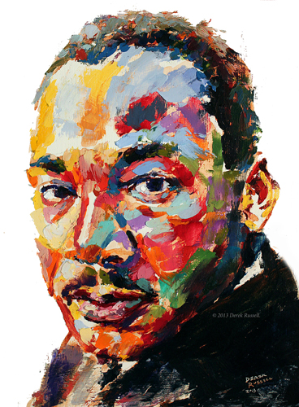
“He went around and told people
what he believed. I believe,
I believe, I believe, he told people.
And people who believed what he
believed took his cause,
and they made it their
own, and they
told people.”
15:00

Slide 87
3. With your character
diamond in mind,
re-write your 16 True Statements so they become “We Believe…”

Slide 88
These sentences
should highlight
Products, Processes, Procedures, Pricing, Warranties, Training,
History and Personality
of the company.

Slide 89
Partners,
review what has
been written.
Help expand
and enliven it.

Slide 90
4. Stand and read
your 16 “We Believe” statements to the room.

Slide 91
5. Partners,
help create 8 or 9 brandable chunks:
memorable, musical,
signature phrases from
the 16 True Statements.
Consider paired opposites when applicable.

Slide 92
6. Present your character diamond and your brandable chunks.

Slide 93
North
Star
Obvious
Vulnerability
Weakness or Flaw
Core
Identity
CounterStar
Surprise

Slide 94
Scientific American published an essay on May 8, 2013, quoting Jonathan Haidt, author of The Righteous Mind,
“The human mind is a story processor, not a
logic processor. Everyone loves a good story;
every culture bathes its children in stories.”

Slide 95
Scientific American published an essay on May 8, 2013, quoting Jonathan Haidt, author of The Righteous Mind,
“The human mind is a story processor, not a
logic processor. Everyone loves a good story;
every culture bathes its children in stories.”
The purpose of these stories is to engage and educate the emotions. Stories teach us character types, plots, and the social-rule dilemmas prevalent in our culture.

Slide 96
The Zero Moment of Truth (ZMOT) occurs when a customer is consciously in the market for a particular product or service. This is that moment when an undecided customer who hasn’t already made the choice in their heart is most likely to search for information.

Slide 97
The Zero Moment of Truth (ZMOT) occurs when a customer is consciously in the market for a particular product or service. This is that moment when an undecided customer who hasn’t already made the choice in their heart is most likely to search for information.
So online information definitely matters.

Slide 98
The Zero Moment of Truth (ZMOT) occurs when a customer is consciously in the market for a particular product or service. This is that moment when an undecided customer who hasn’t already made the choice in their heart is most likely to search for information.
So online information definitely matters.
But a great story can still win the day.
Your bond with a customer will be built on emotion, not information.

Slide 99
Although stories exist primarily to transfer emotion, they’re excellent at communicating information, as well.
We use logic inside stories better than we do outside them.

Slide 100
Although stories exist primarily to transfer emotion, they’re excellent at communicating information, as well.
We use logic inside stories better than we do outside them.
Leda Cosmides and John Tooby have shown that the Wason Selection Test can be solved by fewer than 10 percent when presented as
a logic puzzle, but 70+ percent solve it when it’s presented as a story involving detection
of social-rule cheating.

Slide 101
Bottom line:
Stories are 7 times
more effective than logic.

Slide 102
My Dad never worked for Goettl. He was a self-employed air conditioning repairman named Duncan Goodrich. But he admired the Goettl Brothers like airplane people admired Orville and Wilbur Wright. The Wright Brothers were from Dayton, Ohio. The Goettl Brothers were from here. The Wright Brothers were awarded 7 patents for their aircraft innovations. The Goettl Brothers were awarded one hundred and fourteen. Hundreds of millions of people owe their summertime comfort to the Goettl Brothers of Phoenix. My Dad believed in Goettl. He told me never to buy anything else.
So I saved up my money and I bought the company.

Slide 103
As a boy, I held the flashlight for Dad when he fixed air conditioners at night. That flashlight was important to me. So when we arrive at your home, we're going to give you a Goettl flashlight because you're important to me, too. When your system needs attention - no matter what brand it is - call Goettl. No one knows air conditioners like Goettl. No one. Gee Oh Ee, T-T-L. It'll keep you cool,
but it's hard to spell.

Slide 104
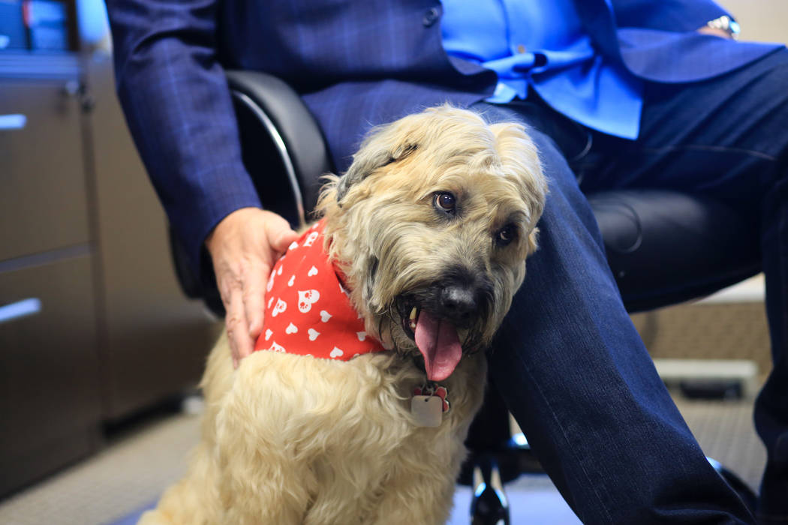

Slide 105
The best home service companies do background checks and drug tests on prospective employees, but at Goettl Air Conditioning we take those evaluations even further, because we want you to LIKE the people who come to your home. I mean really LIKE them. This is going to sound crazy, I know, but I make sure my dog Sadie is there when I meet a prospective new hire. Sadie is a Wheaten Terrier. If Sadie goes straight to a person and gives them her Wheaten Greetin', I know you're going to be really comfortable with that person in your home. But if Sadie goes off and hides, there's no way that person is comin' to work for Goettl. Sadie is never wrong.

Slide 106
So now you know I'm crazy. But isn't it okay to be crazy about hiring likable, happy people that will make sure the customer is delighted?
Isn't it okay to be crazy about old fashioned
Do-The-Right-Thing customer service?
Goettl is a fabulous company to work for,
and it’s a fabulous company to call. Because everyone who works here is Sadie Certified.

Slide 108
1. Write an ad
that is the sequel to
your origin story that
you can read out loud in 60 seconds or less. Your partners will help you.

Slide 109
Open Big.

Slide 110
Open Big.
Be Relevant.

Slide 111
Open Big.
Be Relevant.
Be Credible.

Slide 112
Open Big.
Be Relevant.
Be Credible.
Entertain.
(Be interesting!)

Slide 113
Open Big.
Be Relevant.
Be Credible.
Entertain.
(Be interesting!)
Close Big.

Slide 114
When you have
written your first
message, begin
a second one
if you have time.

Slide 115
2. Yes, you will stand
and read these.

